Slide 1
Orthogonality and Least Squares
INNER PRODUCT, LENGTH, AND ORTHOGONALITY

Slide 2

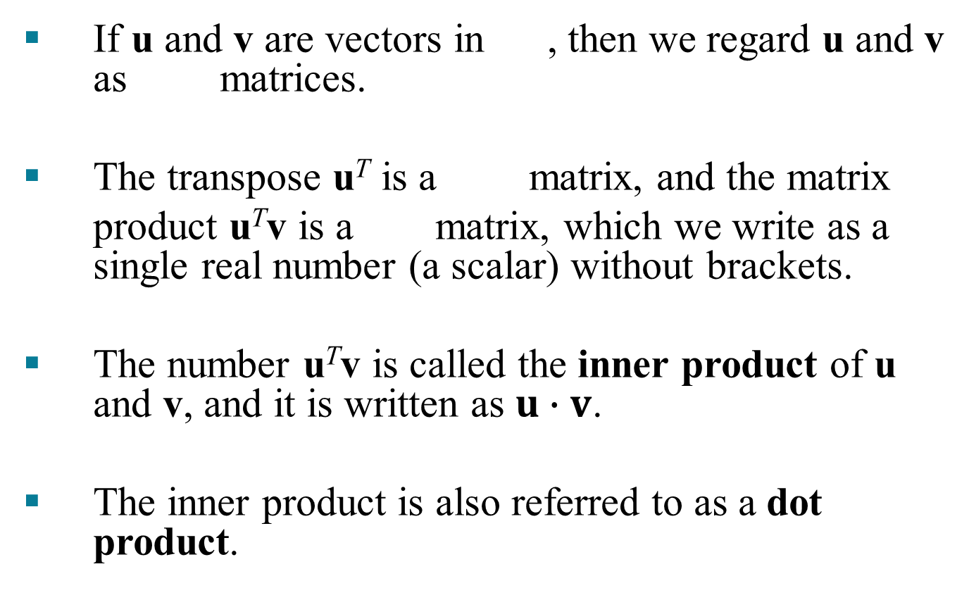
INNER PRODUCT
$$ℝ^{n}$$
If u and v are vectors in , then we regard u and v as matrices.
The transpose u^{T} is a matrix, and the matrix
product u^{T}v is a matrix, which we write as a single real number (a scalar) without brackets.
The number u^{T}v is called the inner product of u and v, and it is written as $u∙v$.
The inner product is also referred to as a dot product.

Slide 3
INNER PRODUCT
If and ,
then the inner product of u and v is
.

Slide 4

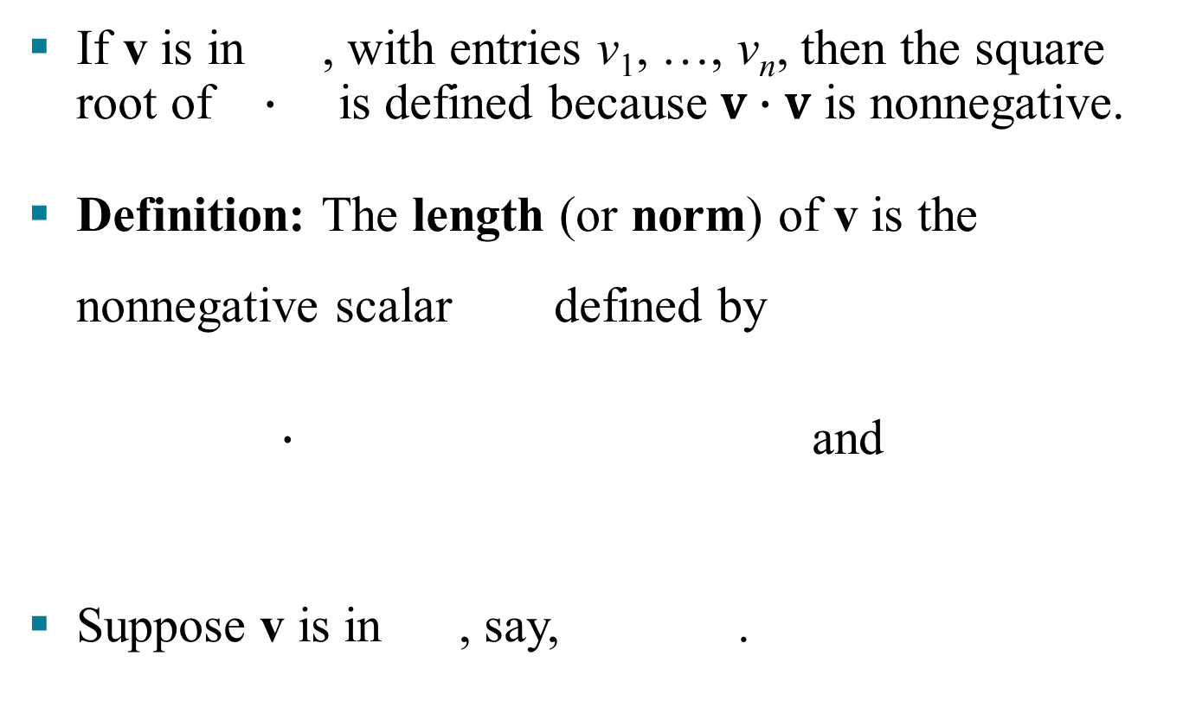


THE LENGTH OF A VECTOR
$$ℝ^{n}$$
If v is in , with entries v₁, …, v_{n}, then the square root of $∙$ is defined because $v∙v$ is nonnegative.
Definition: The length (or norm) of v is the nonnegative scalar defined by
$∙$ and
Suppose v is in , say, .
$$∙$$
$$ℝ^{2}$$

Slide 5
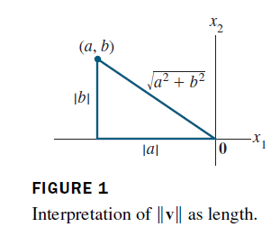
THE LENGTH OF A VECTOR
If we identify v with a geometric point in the plane, as usual, then coincides with the standard notion of the length of the line segment from the origin to v.
This follows from the Pythagorean Theorem applied to a triangle such as the one shown in the following figure.

Slide 6
THE LENGTH OF A VECTOR
For any scalar c, the length cv is times the length of v. That is,
A vector whose length is 1 is called a unit vector.
If we divide a nonzero vector v by its length—that is, multiply by —we obtain a unit vector u because the length of u is .
The process of creating u from v is sometimes called normalizing v, and we say that u is in the same direction as v.

Slide 7
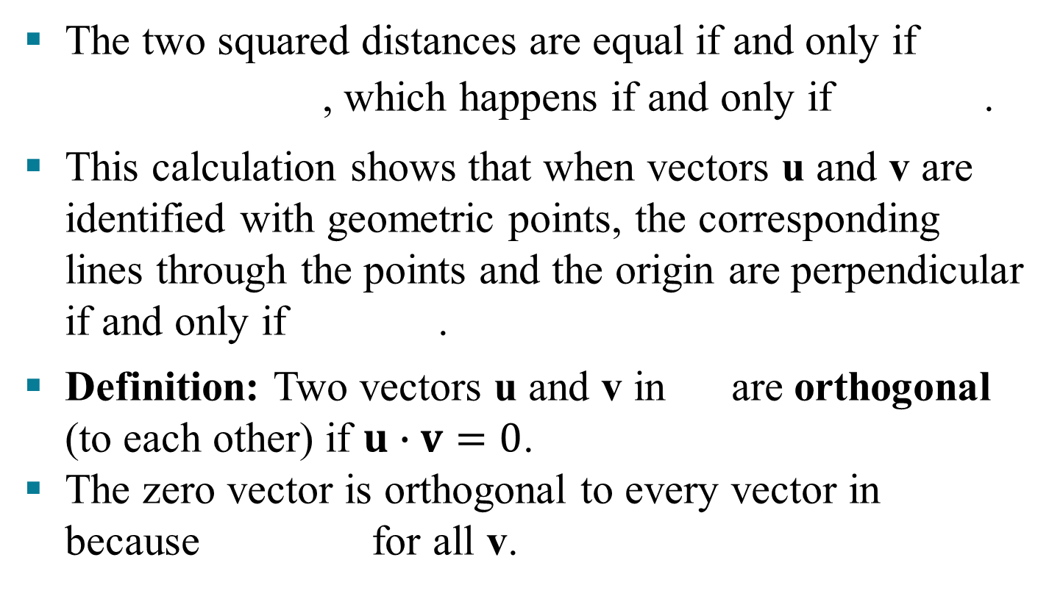


ORTHOGONAL VECTORS
The two squared distances are equal if and only if
, which happens if and only if .
This calculation shows that when vectors u and v are identified with geometric points, the corresponding lines through the points and the origin are perpendicular if and only if .
Definition: Two vectors u and v in are orthogonal (to each other) if $u∙v=0$.
The zero vector is orthogonal to every vector in because for all v.
$$ℝ^{n}$$
$$ℝ^{n}$$

Slide 8

INNER PRODUCT
Theorem 1: Let u, v, and w be vectors in , and let c be a scalar. Then
, and if and only if
Properties (b) and (c) can be combined several times to produce the following useful rule:
$$ℝ^{n}$$

Slide 9
THE LENGTH OF A VECTOR
Example 1: Let . Find a unit vector u in the same direction as v.
Solution: First, compute the length of v:
Then, multiply v by to obtain

Slide 10


DISTANCE IN
$$ℝ^{n}$$
To check that , it suffices to show that .
Definition: For u and v in , the distance between u and v, written as dist (u, v), is the length of the vector
. That is,
$$ℝ^{n}$$

Slide 11

DISTANCE IN
$$ℝ^{n}$$
Example 2: Compute the distance between the vectors and .
Solution: Calculate
The vectors u, v, and are shown in the figure on the next slide.
When the vector is added to v, the result is u.

Slide 12
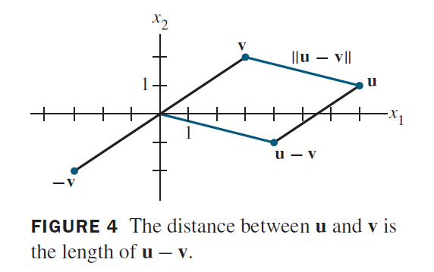

DISTANCE IN
$$ℝ^{n}$$
Notice that the parallelogram in the above figure shows that the distance from u to v is the same as the distance from to 0.

Slide 13
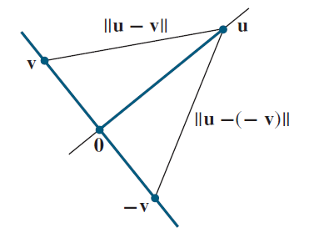


ORTHOGONAL VECTORS
Consider or and two lines through the origin determined by vectors u and v.
See the figure below. The two lines shown in the figure are geometrically perpendicular if and only if the distance from u to v is the same as the distance from u to .
This is the same as requiring the squares of the distances to be the same.
$$ℝ^{2}$$
$$ℝ^{3}$$

Slide 14

ORTHOGONAL VECTORS
Now
The same calculations with v and interchanged show that
Theorem 1(b)
Theorem 1(a), (b)
Theorem 1(a)

Slide 15

THE PYTHOGOREAN THEOREM
Theorem 2: Two vectors u and v are orthogonal if and only if .
Orthogonal Complements
If a vector z is orthogonal to every vector in a subspace W of , then z is said to be orthogonal to W.
The set of all vectors z that are orthogonal to W is called the orthogonal complement of W and is denoted by (and read as “W perpendicular” or simply “W perp”).
$$ℝ^{n}$$

Slide 16

ORTHOGONAL COMPLEMENTS
A vector x is in if and only if x is orthogonal to every vector in a set that spans W.
is a subspace of .
Theorem 3: Let A be an matrix. The orthogonal complement of the row space of A is the null space of A, and the orthogonal complement of the column space of A is the null space of A^{T}:
and
$$ℝ^{n}$$

Slide 17

ORTHOGONAL COMPLEMENTS
Proof: The row-column rule for computing Ax shows that if x is in Nul A, then x is orthogonal to each row of A (with the rows treated as vectors in ).
Since the rows of A span the row space, x is orthogonal to Row A.
Conversely, if x is orthogonal to Row A, then x is certainly orthogonal to each row of A, and hence .
This proves the first statement of the theorem.
$$ℝ^{n}$$

Slide 18
ORTHOGONAL COMPLEMENTS
Since this statement is true for any matrix, it is true for A^{T}.
That is, the orthogonal complement of the row space of A^{T} is the null space of A^{T}.
This proves the second statement, because
.

Slide 19





ANGLES IN AND (OPTIONAL)
$$ℝ^{2}$$
$$ℝ^{3}$$
$$ℝ^{2}$$
$$ℝ^{3}$$
If u and v are nonzero vectors in either or , then there is a nice connection between their inner product and the angle between the two line segments from the origin to the points identified with u and v.
The formula is
(1)
To verify this formula for vectors in , consider the triangle shown in the figure on the next slide with
sides of lengths, , , and .
$$ℝ^{2}$$

Slide 20
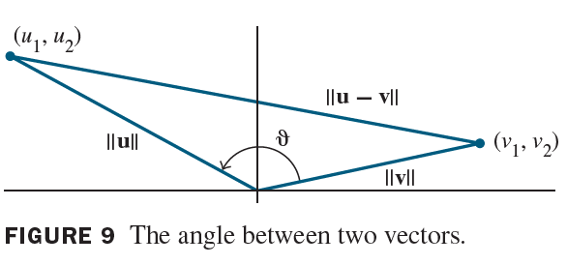

ANGLES IN AND (OPTIONAL)
$$ℝ^{2}$$
$$ℝ^{3}$$
By the law of cosines,
which can be rearranged to produce the equations on the next slide.

Slide 21

ANGLES IN AND (OPTIONAL)
$$ℝ^{2}$$
$$ℝ^{3}$$
The verification for is similar.
When , formula (1) may be used to define the angle between two vectors in .
In statistics, the value of defined by (1) for suitable vectors u and v is called a correlation coefficient.
$$ℝ^{3}$$
$$ℝ^{n}$$

